Slide 1
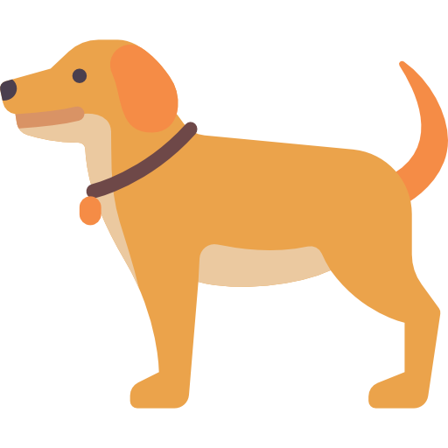


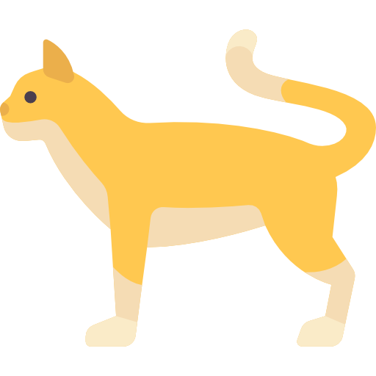


Input Raw Data
Output
Dog
Labeling Data
Algorithm
Training Model
Cat

Slide 2
Algorithm

Slide 3
:labeled data

Slide 4
Agent
滅火
State
Reward
Action
衝進火場
Environment

Slide 5

Pre-text task
Downstream task
Raw Data
Self-Supervised Learning
Supervised Learning

